Slide 1
STD SURVEILLANCE INSIGHT PRESENTATION · 2015–2025
A Decade of STD Trends
From Data to Action: Reducing the Global Burden of STDs
Strategic Insights for Global Health Stakeholders · Donors · Policymakers · International Organizations

Slide 2
Why This Matters
336.9M
15.7M
25–49
Global STD Cases
Lives Lost
Most Affected Age Group (Years)
2015–2025 cumulative
Preventable deaths
Disproportionate impact in low- and middle-income regions (LMICs)
Economically active populations bear the heaviest burden
Health systems in high-burden regions face compounding strain
KEY MESSAGE → The burden is not just high — it is persistent and unevenly distributed

Slide 3
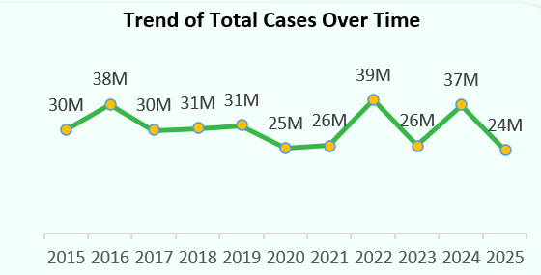
ARE WE WINNING THE FIGHT?
Global Trends: Progress or Plateau?
GLOBAL OVERVIEW
OBSERVED TRENDS
Trend
Annual cases fluctuate between 25M and 39M globally
No sustained downward trajectory observed over the decade
Improved diagnostics partly inflate reported case numbers
ROOT CAUSES
Inconsistent and fragmented prevention strategies
Behavioral shifts across demographics
Structural gaps in healthcare access
KEY MESSAGE → We are managing STDs — not reducing them

Slide 4
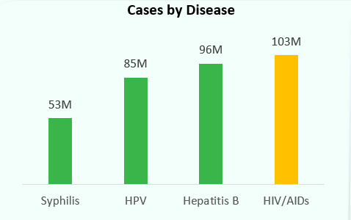
GLOBAL TRENDS
Disease Burden Composition
GLOBAL DISEASES
HIV/AIDS
Hepatitis B
HPV
Syphilis
The most prevalent
Vaccination gaps remain
Widespread, vaccine preventable
Persistent transmission
KEY MESSAGE → A small cluster of diseases drives the majority of the global burden

Slide 5
DISEASE PROFILE
Africa: Disproportionate Impact
80M
4M
#1
Cases in Africa
Deaths in Africa
Nigeria — Highest Burden
Highest STD mortality rates globally
HIV/AIDS is the most prevalent and clinically severe disease
Limited healthcare access accelerates late-stage diagnoses
Socioeconomic barriers compound prevention and treatment gaps
KEY MESSAGE → Africa is the epicenter of severe outcomes — not just high incidence
STD Global Intelligence Report · 2015–2025

Slide 6
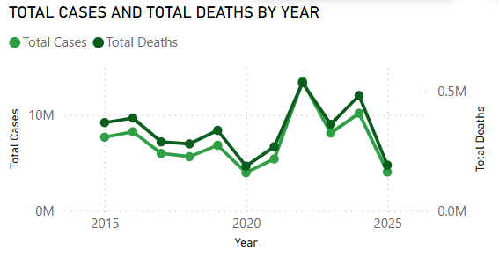
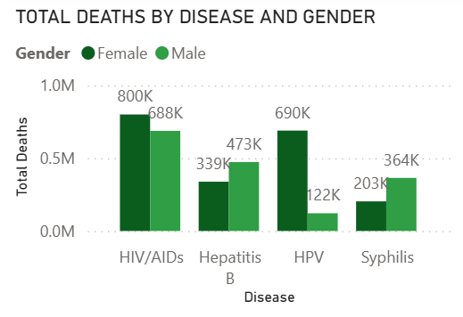
Africa: Trends & System Gaps
AFRICA ANALYSIS
WHAT WE SEE
SYSTEM FAILURES
GENDER DISPARITIES
WHAT WE SEE
SYSTEM FAILURES
Strong correlation between case counts and death rates
Fluctuating but persistently high trends since 2015
Weak early detection & surveillance systems
Inconsistent and inequitable treatment access
Women: HPV & HIV disproportionate exposure
Men: late-stage presentation in Hepatitis B care
KEY MESSAGE → Mortality is driven more by system gaps than by disease spread alone

Slide 7
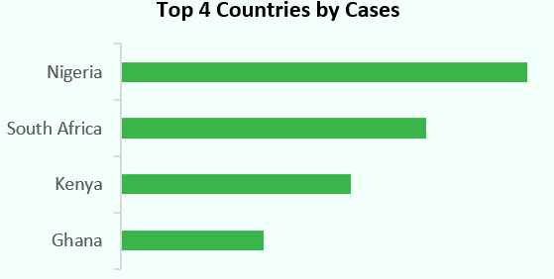
Where the Burden is Concentrated
Nigeria
Highest burden
South Africa
High burden
Kenya
Significant burden
Ghana
Moderate–high burden
Population density and urbanization amplify transmission
Health system capacity varies dramatically across countries
Targeting top countries = continental-level impact

Slide 8
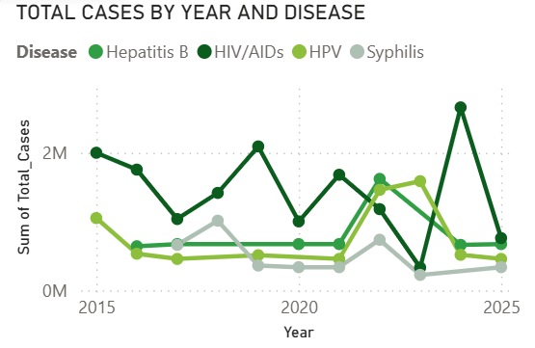
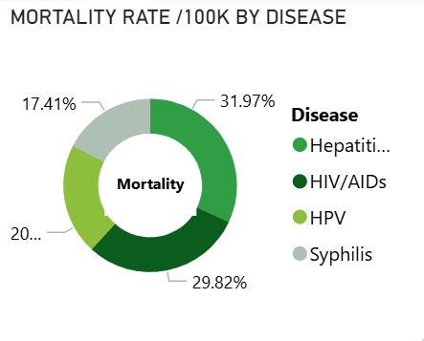
COUNTRY DEEP DIVE: GHANA
Ghana: A Microcosm of the Challenge
OBSERVATIONS
GHANA FOCUS
UNDERLYING CAUSES
Fluctuating STD trends throughout 2015–2025
HIV/AIDS spikes coincide with periods of reduced intervention
Hepatitis B rates showing signs of stabilization
UNDERLYING CAUSES
Intermittent effectiveness of prevention programs
Behavioral risk shifts among key populations
Gaps in sustained, long-term prevention coverage
STD Global Intelligence Report · 2015–2025
KEY MESSAGE → Ghana reflects both meaningful progress and persistent vulnerability

Slide 9
Ghana: Mortality & Risk Outlook
Late-Stage Diagnosis
Low Vaccination
Treatment Adherence Gaps
Patients reaching care at advanced disease stages
Only a fraction of at-risk individuals are screened annually
Inconsistent adherence to long-term antiretroviral therapy
PREDICTION | Mortality will remain persistently high without substantial improvements in early detection and screening access.
KEY MESSAGE → Deaths are preventable — but only with earlier and wider intervention

Slide 10
The Next Decade: Two Possible Futures
⚠ IF CURRENT TRENDS CONTINUE
✓ IF INTERVENTIONS IMPROVE
CRITICAL
VERY HIGH
Cases fluctuate — no meaningful decline achieved
Africa remains a persistently high-burden region
HIV/AIDS continues to dominate mortality statistics
System gaps widen as populations grow
Mortality declines first as treatment access improves
Case reductions follow with sustained prevention programs
High-burden countries show measurable progress
Health system capacity grows to meet demand
HIGH
MEDIUM
FOUNDATIONAL
KEY MESSAGE → The future is highly responsive to policy decisions and sustained investment

Slide 11
Our Propose Solutions to Curb the Menace
01
Scale Early Detection
02
Target High-Burden Diseases
03
Geographic Precision
Routine, integrated STD screening targeting high-risk age groups
Expand HIV/AIDS treatment; accelerate Hepatitis B & HPV vaccination
Data-driven targeting in Nigeria and other high-density settings
04
Close Gender Gaps
05
Strengthen Health Systems
HPV prevention for women; Hepatitis B & late-stage care access for men
Ensure continuity of care and long-term program funding
KEY MESSAGE → Precision — not just scale — will determine the next decade's outcomes

Slide 12
CALL TO ACTION
WHO & Global Leaders
edical Community
What is needed now is coordinated, sustained, and adequately funded action.
Donors & Funders
WHO & Global Leaders
Medical Community
Invest in targeted, high-impact STD interventions
Standardize and scale proven best practices globally
Prioritize early detection and integrated STD care
Fund early detection infrastructure in Africa
Mandate integrated STD surveillance systems
Expand community-level screening programs
Support 10-year program continuity — not 1-year grants
Drive country-level accountability frameworks
Champion HPV and Hepatitis B vaccination campaigns
The burden is high · The causes are understood · The solutions are known · The time to act is now.

Slide 13
The Data Is Clear. The Solutions Are Known.
Data is Clear.
The Path Forward Requires Coordinated Action.
✓
The Burden is High
✓
The Causes are Known
336.9M global cases, 15.7M deaths
HIV/AIDS, Hep-B, HPV, Syphilis drive 80%+ of burden
✓
The Solutions Exist
✓
Action Must be Now
Screening, vaccination, treatment access, targeted programs
Delay costs lives — each year of inaction deepens the gap
What's needed now is coordinated, sustained, and precision-driven action.

Slide 14
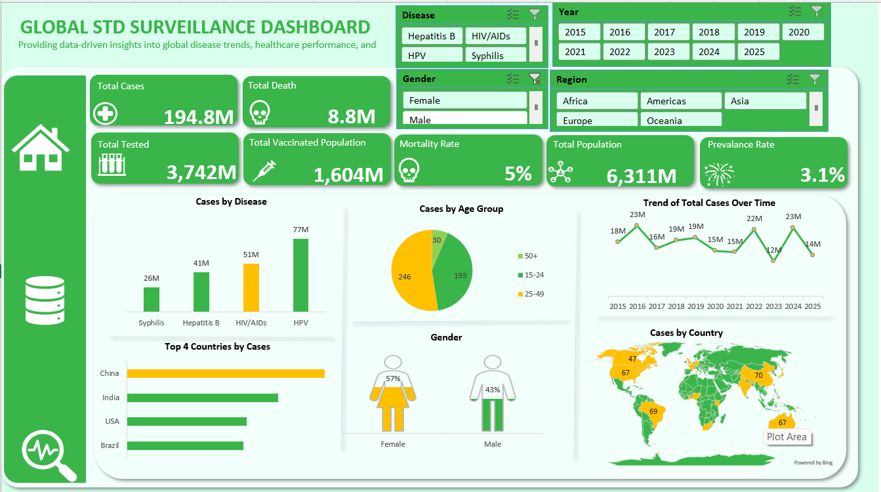

Slide 15
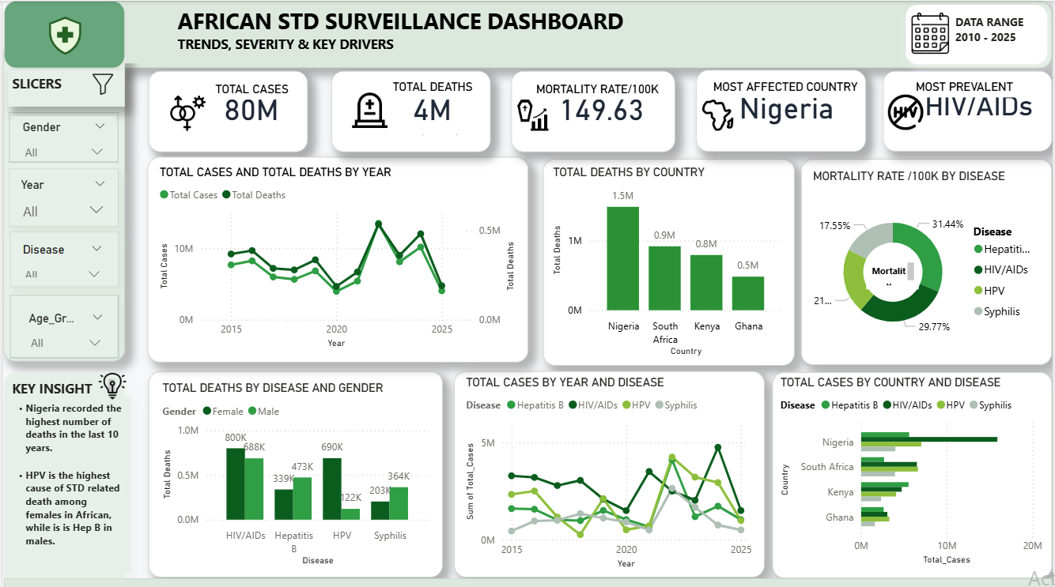

Slide 16
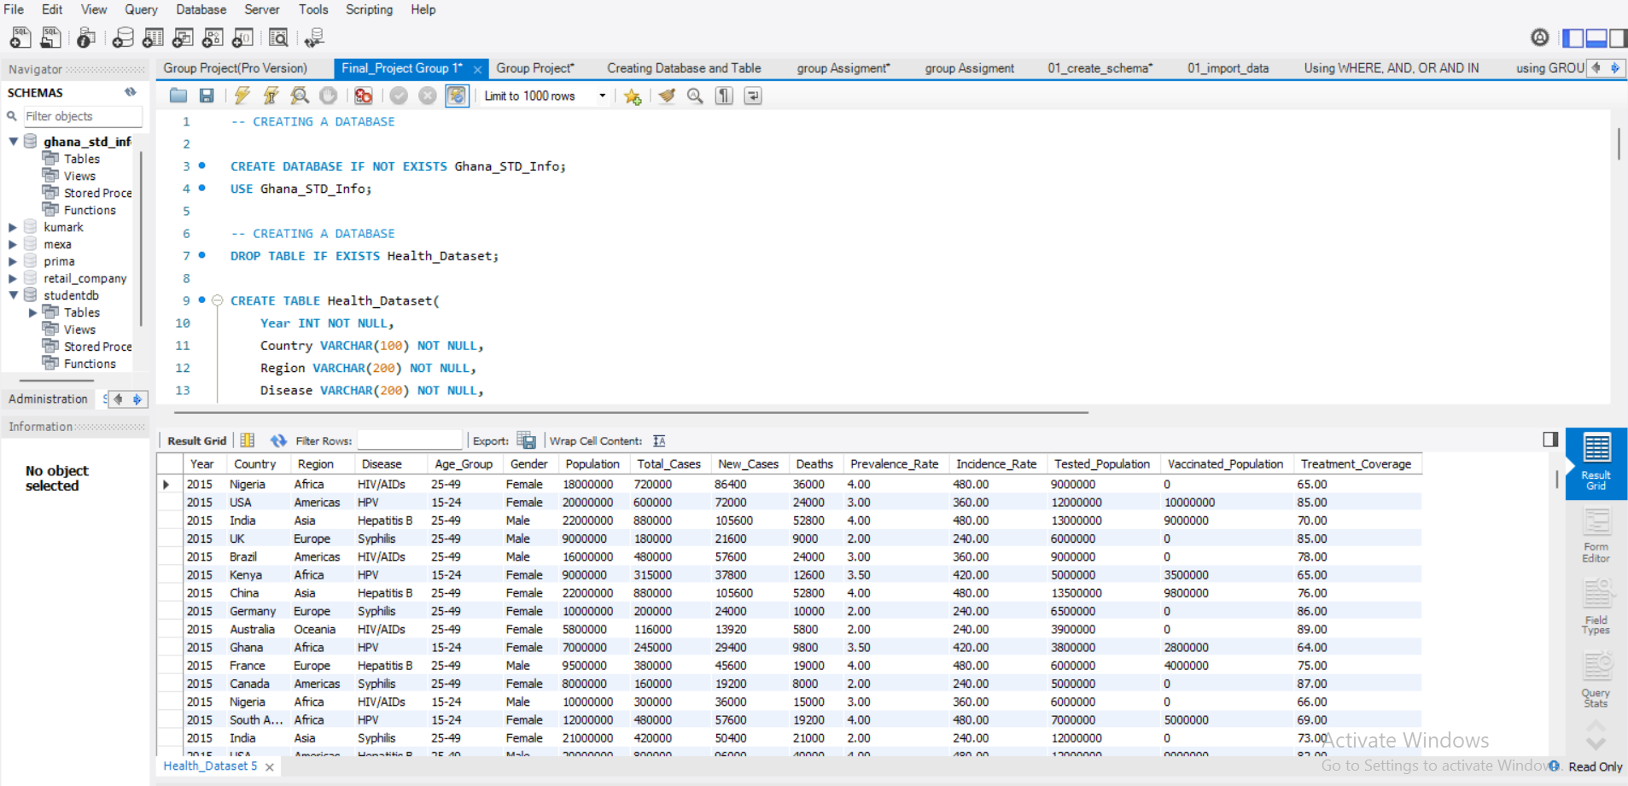

Slide 17
THANK YOU
STD Surveillance Insight Report · 2015–2025
The burden is high · The causes are understood · The solutions are known · The time to act is now.

